Slide 1
Azure Data Bricks

Slide 2
Introduction
Apache spark-based analytics platform optimized for Microsoft Azure cloud services
Provides one-click setup, streamed workflow and provides interactive workspace between data scientists, data engineers and data analysts

Slide 3
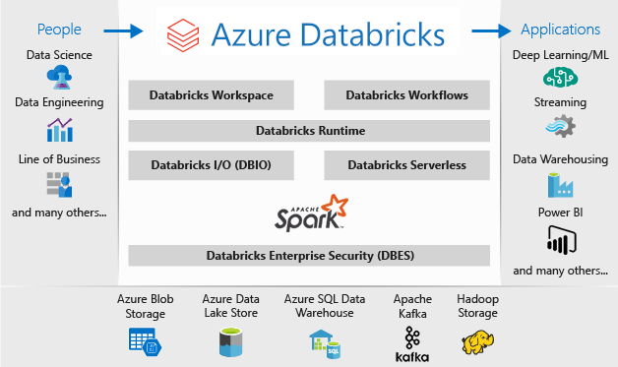
Azure Data Bricks Overview

Slide 4
Multiple sources of data
Data analytics in Azure data bricks uses data from multiple sources:
Azure Data Lake
Azure Cosmos DB
Azure Blob storage
Azure SQL Data Warehouse
Data bricks converts the data into meaningful insights using Spark

Slide 5
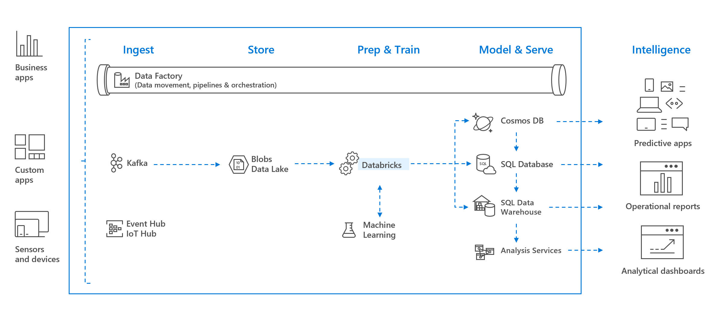
Data bricks Pipeline

Slide 6
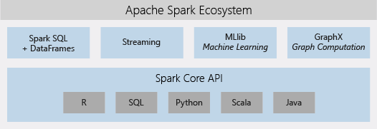
Apache Spark Ecosystem
Comprises the complete open-source Apache spark cluster technologies and capabilities

Slide 7
Apache Spark Components
Spark SQL and Data frames
Spark module for working with structured data. Data frame is a distributed collection of data organized in named columns
Streaming
Real time data processing and analytics which integrates HDFS, Flume and Kafka
MLlib
Machine learning library consisting of common machine learning algorithms and utilities

Slide 8
Apache Spark Components (Contd…)
GraphX
Graph computation for broad scope use case of cognitive analytics
Spark Core API
Includes support for R, Python, Scala and Java

Slide 9
Apache Spark in Azure Data bricks - 1
Fully managed Apache Spark clusters
Create clusters in seconds
Dynamic auto scaling of clusters up and down including serverless clusters
Use clusters programmatically using REST APIs
Get instant access to latest Apache Spark features
Databricks Runtime
Azure cloud native built on top of Spark
Spark engine that is faster and performant through various optimizations at the I/O layer and processing layer (Databricks I/O)

Slide 10
Apache Spark in Azure Data bricks - 2
Workspace for Collaboration
Determine how to use data with easy data exploration
Document the progress in notebook
Visualize data in few clicks
Interactive dashboards to create dynamic reports
Interact with data simultaneously using Spark

Slide 11
Workspace
An environment for accessing all databricks assets
The workspace organizes objects into folders and provides access to data and other computational resources
Workspace can be managed through Workspace UI, Databricks CLI and Databricks REST API

Slide 12
Cluster
Databricks cluster is a set of computational resources and configurations on which you need can run data engineering, data science and data analytics workloads such as streaming and ad-hoc analytics and machine learning
There are two types of Clusters
Interactive clusters can be manually created, restarted and terminate. Such clusters can be shared among multiple users to do interactive analysis
Automated cluster which will be created automatically when a job is run and terminated as soon as job is completed

Slide 13
Workload
There are two types of Workloads that Databricks support
Data Engineering – An automated workload that runs on automated cluster which the Databricks job scheduler creates for each workload
Data Analytics – An interactive workload that runs on interactive cluster within Azure Databricks notebook. Running a job on existing automated cluster is also treated as interactive workload

Slide 14
Notebook
Web based interface to a document that contains runnable code, visualizations and narrative
Following are the features of notebook
Manage notebooks
Notebook-scoped python libraries
Visualizations
Dashboards
Widgets
Workflows
Jobs

Slide 15
Dashboard
Dashboards allow to visualize data from notebook output and share them in a presentable format
Dashboard doesn’t provide live view of data from the dashboard. It needs to be refreshed in specific intervals and the refresh can be scheduled through notebook

Slide 16
Libraries
Libraries can be installed to make external code(locally-built or third-party) available to notebooks and jobs that run on cluster
Azure Databricks supports three types of library modes
Workspace library
Has same attributes as that of Cluster installed library, plus its path in workspace
A template from which cluster installed library can be created – shared path or user folders
Cluster Installed library
Notebook-scoped library

Slide 17
Databricks File System (DBFS)
Distributed file system mounted into Azure Databricks workspace and available across all clusters
Abstraction on top scalable object storage
Following are the benefits
Allows to mount storage objects and hence makes data access seamless without requiring storage credentials
Allows to interact with directories and files directly
Persist data to object storage and files remain even after terminating the cluster

Slide 18
Databases and Tables
Databricks database is a collection tables and table is a collection of structured data
There are two types of tables which are global and local. Global tables are available across all the clusters and local tables in a cluster are not accessible from other cluster
Tables can be queried using Spark API or Spark SQL
The data can be cached, filtered and can perform any type of operations supported by Apache Spark Dataframes

Slide 19
Databricks Runtime
Set of core components that run on clusters
Several types of run times
Databricks Runtime
Databricks Runtime for Machine Learning
Databricks Runtime for Genomics
Databricks Light

Slide 20
Authorization
User
Group
Access Control List

